Slide 1
Introduction to Smart Home System
presented by Alex, Choi, Long, Oscar, and Sam

Slide 2
Outline
Introduction
Architecture
Interaction and Communication
Remote Communication
User Interaction
Smart Devices
Smart lighting
Smart Security System using Raspberry Pi
Safety/Privacy Concerns
Conclusion

Slide 3
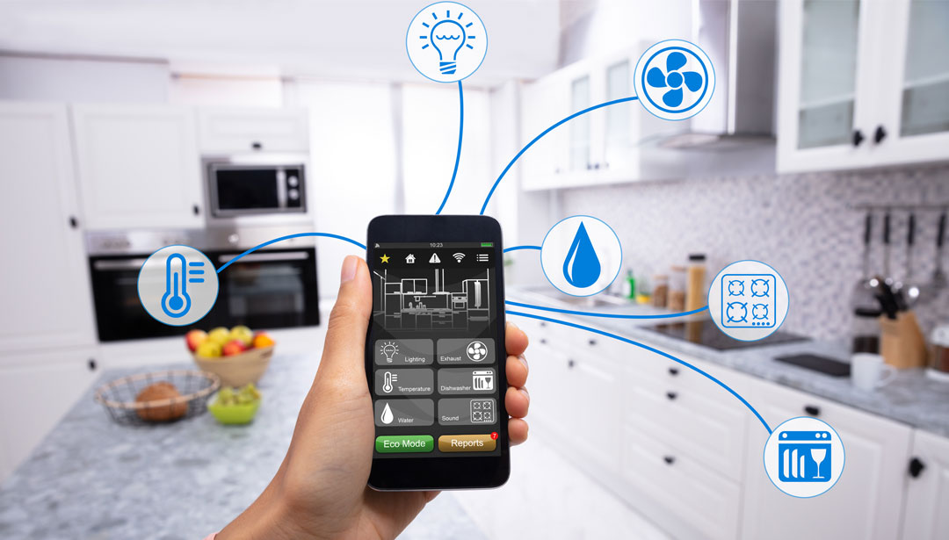
Introduction
Smart home system
A home automation system monitors and control home attributes such as lighting, climate, entertainment systems, and appliances.
Figure 1. Phone controlling the smart devices

Slide 4
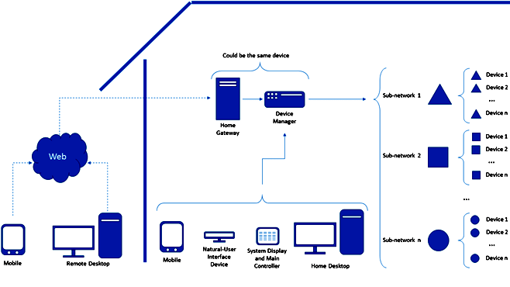
Architecture of a smart home system
Communication
Home Gateway
Device Manager
Control
Remote access
Home access and Main Controller
Natural-User Interface Devices
Peripherals
Desktop and Mobile Devices
Sub-networks and Connected Devices
Figure 2. Architecture of the smart home
References: Salazar, A., 2016. Towards the Evolution of Smart Home Environments: A Survey. International Journal of Automation and Smart Technology, 6(3), pp.109-113.

Slide 5
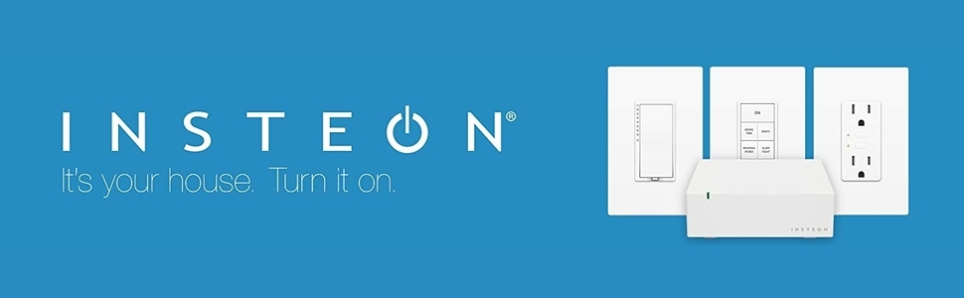



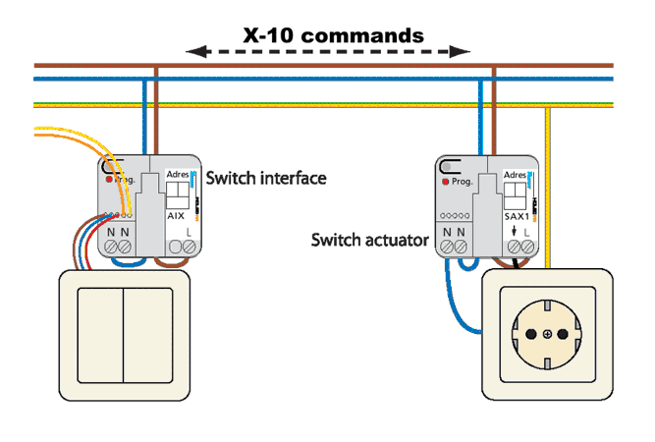
Interaction and Communication
How do smart devices communicate?
Using device manager to tie all the devices together and transmit signal and data based on different means and protocols.
Protocols:
X10
Insteon
Z-Wave
Zigbee
Wifi
Bluetooth
Figure 3. Various protocols for interaction and communication
Reference: Yang, H., Lee, W. and Lee, H., 2018. IoT Smart Home Adoption: The Importance of Proper Level Automation. Journal of Sensors, 2018, pp.1-11.

Slide 6
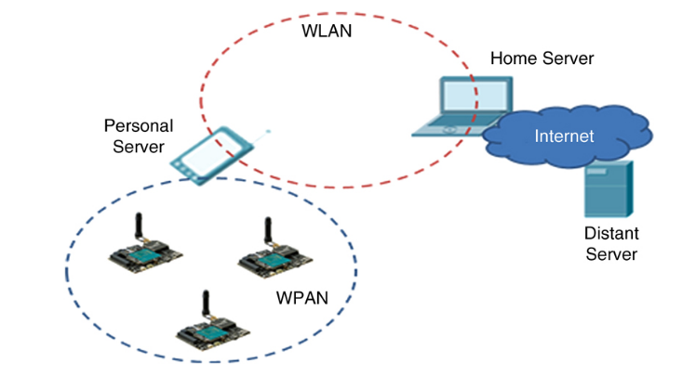
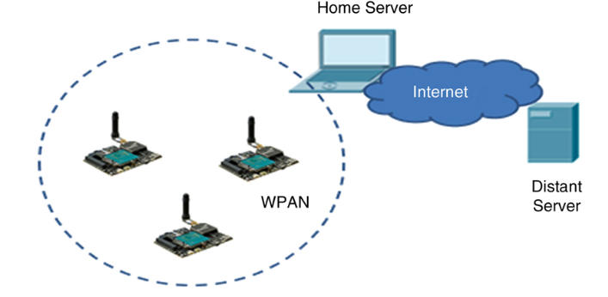
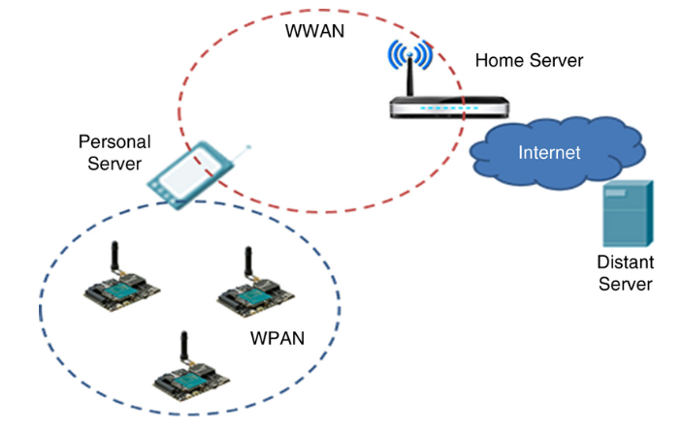
Remote Communication
Devices in the system are connected wirelessly through Wireless Sensor Networks (WSNs), which are: Wireless Local Area Network (WLAN), Wireless Personal Area Network (WPAN - ie. Bluetooth, Zigbee), Wireless wide area network (WWAN - ie. 3G/4G/5G).
Figure 4. Use of WPAN and WLAN
Figure 5. Use of WPAN only
Figure 6. Use of WPAN and WWAN
First Access Technology,
Use of WPAN and WLAN
- Wireless sensors send data to the personal server (commonly a smartphone) using WPAN. The personal server then connects to the home server and forwards data using WLAN.
- Best for home usage.
Second Access Technology,
Use of WPAN only
- Wireless sensors send data directly to the home server using WPAN.
- Cheapest (fewer devices needed) but wireless sensors require more energy to access the home server with WPAN.
Third Access Technology,
Use of WPAN and WWAN
- Wireless sensors send data to the personal server using WPAN. The personal server collects then forwards data to the home server using WWAN.
- Allow home server to be very far away.
Images and References: Obaidat, M. and Nicopolitidis, P., 2016. Smart Cities And Homes. ch.2.

Slide 7
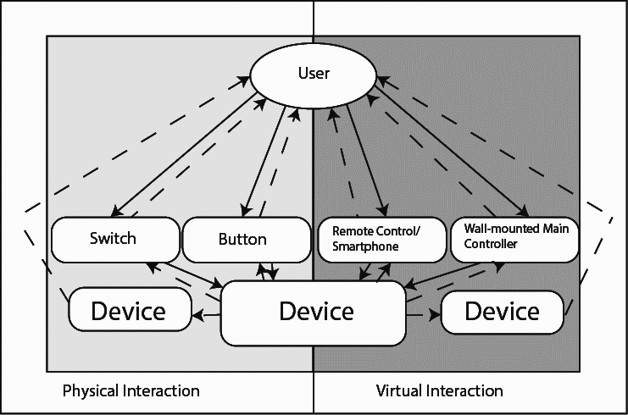
User Interaction
Two Aspects:
Physical Interaction
Virtual Interaction
Main Elements of Interactivity:
Visibility
Affordance
Mapping
Feedback
Constraints
Effectiveness
Efficiency
Satisfaction
Figure 7. Two aspects of user interaction
References: Leitner, G., Ahlstrom, D., Hitz, M., 2007, in IFIP International Federation for Information Processing, Volume 241,
Home Informatics and Telematics: ICT for the Next Billion, eds. Venkatesh, A., Gonsalves, T., Monk, A., Buckner, K.,
(Boston: Springer), pp. 269-278.

Slide 8
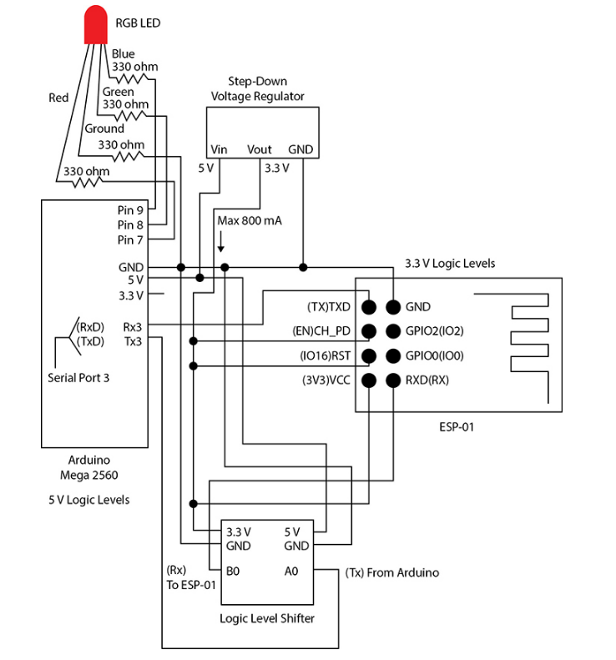


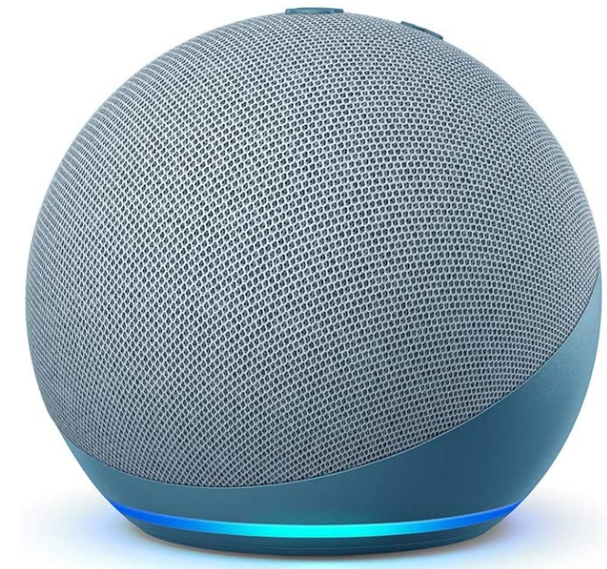
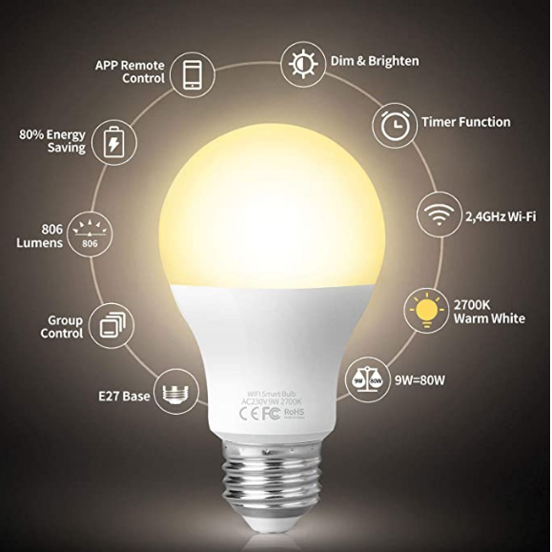
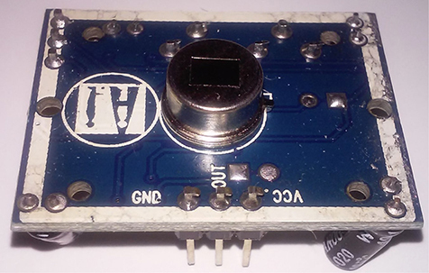
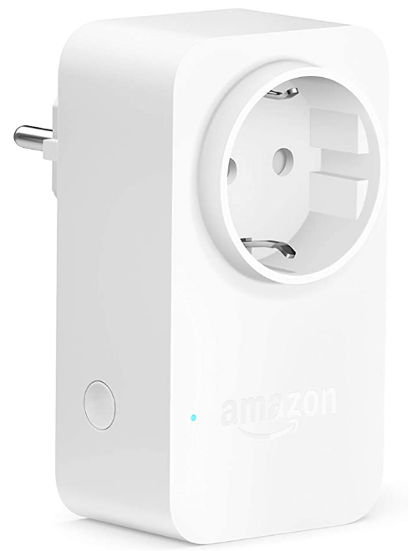
Smart Lighting
(to remotely control lighting)
Examples
Remote Wireless RGB LED Control (Fig. 9) Arduino microcontroller: Device Manager ESP-01 Wi-Fi module: for connectivity Android phone: to control the lighting of the LED
User
Smartphone
Device Manager (Amazon Echo Dot)
Figure 9. Remote Wireless RGB LED Control
Sensor Control with Infrared Motion Detector (Fig. 10)
HC-SR501 Infrared Motion Sensor Movement is detected -> Output is 1 or high voltage No movement is detected -> Output is 0 or low voltage
Fitop Smart LED
Amazon Smart Plug
Figure 8. Common Practice of Smart Lighting
Images from: Amazon.com; Images and References: Chin, R., 2020. A DIY Smart Home Guide. ch.5, 7.
Figure 10. HC-SR501 Infrared Motion Sensor

Slide 9
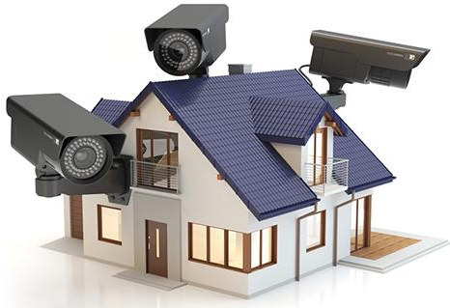
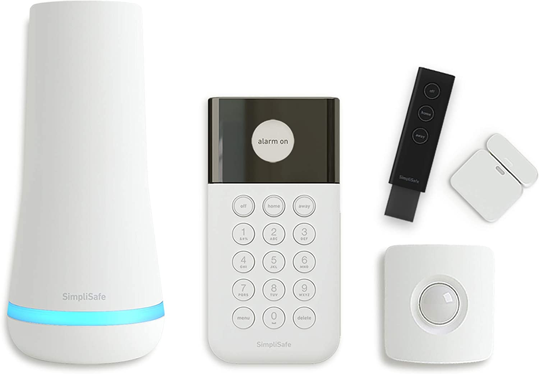
Smart Security System - Definition and Example
Smart Security System
a security arrangement, in which technology is leveraged to monitor your premises and alert you in case of unfavourable incidents like trespassing.
Example: DIY home security kit
Any unusual movements detected by sensors will be notified to the user
Recorded footage of surveillance camera will be stored in Clouds for future usage.
Emergency system can be initiated by users from distance in order to alert the local authority for immediate action
Figure 11. Smart Security System
Figure 12. Simplisafe
References: Thakkar, D. (2019). Smart Home Security: Does Biometrics Make It Any Smarter? [online] Bayometric. Available at: https://www.bayometric.com/smart-home-security-biometrics-make-smarter/.
‌
Notes:
Now I would like to explain

Slide 10
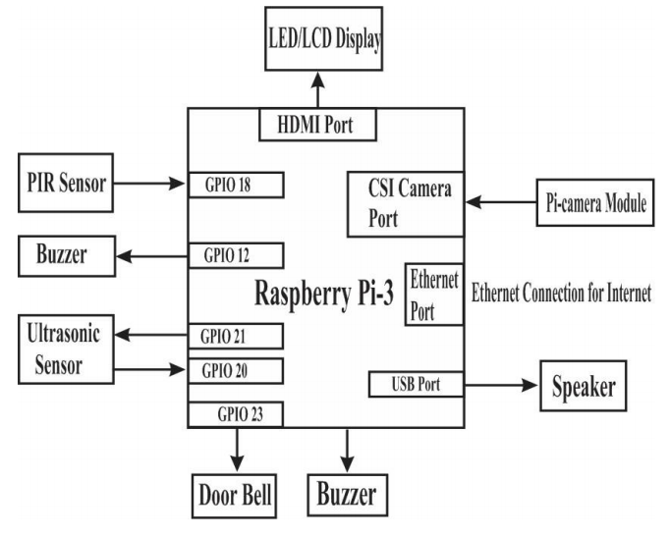
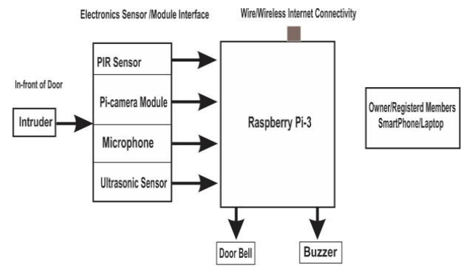
Smart Security System - How it works
The IoT based home security system has been designed and developed with Raspberry Pi-3, PIR sensor, and Pi-camera.
Architecture of Home Security System
Raspberry Pi-3
Process the image
YOLO(You-Only-Look-Once) Algorithm
PIR sensor : motion detector (regardless of visibility)
Pi-camera Module : used to capture the image of intruder
Reference : Deepak.S.Kumbhar, H.C. Chaudhari, Shubhangi S.Bhatambrekar , Shubhangi M.Taur, "IOT BASED HOME SECURITY SYSTEM USING RASPBERRY PI-3", IJRAR - International Journal of Research and Analytical Reviews (IJRAR), E-ISSN 2348-1269, P- ISSN 2349-5138, Volume.6, Issue 1, Page No pp.305-309, January 2019, Available at : http://www.ijrar.org/IJRAR190O064.pdf
Figure 13. Example of Block diagram of Home security system
Figure 14. Example of the Architecture of a home security system

Slide 11
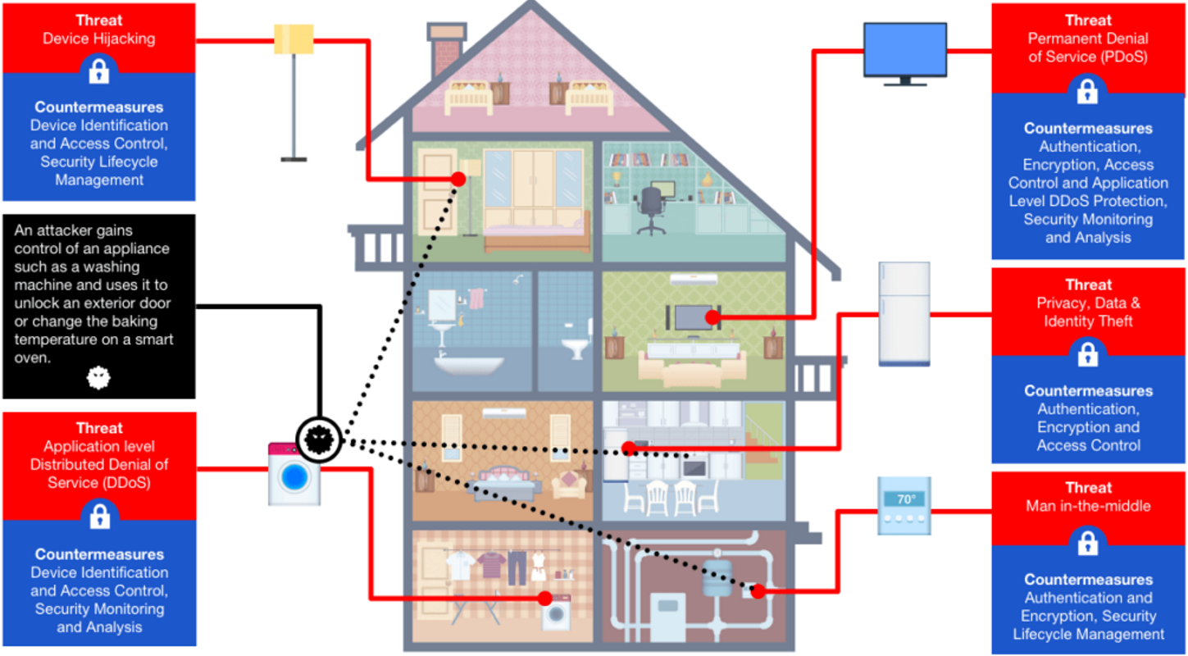
Safety/Privacy Concerns
Image and references: Rambus. 2020. Smart Home: Threats And Countermeasures - Rambus. [online] Available at: <https://www.rambus.com/iot/smart-home>.

Slide 12
Thank you for listening!

